Slide 1
The Impact of Menopause and the
Role of Estrogen in CVD
Gordon C. Gunn, M.D., F.A.C.O.G.
Gynecologic Oncologist
Preventative Medicine Specialist
Hormonal Therapy Consultant
Notes:
Thank you – good morning from California.
I am pleased to share my experience and thoughts with you about these two important topics and how they inter-relate.
Before I begin, I would like to bring to your attention a growing crisis facing us in the U.S. and the entire world - Population Growth in the age groups 65 and over.

Slide 2
Growing Crisis in Healthcare in U.S.
WHY?
Population Aged 65 and Over is Growing Rapidly
U.S. POPULATION Age 65 and Older
(numbers in millions)
1900 to 2060
Year | Population | People 65+ | %
1900 | 76.2 | 3.1 | 4.1
1920 | 106.5 | 4.9 | 4.6
1940 | 132.2 | 9.0 | 6.8
1960 | 180.7 | 16.2 | 9.0
1980 | 226.5 | 25.5 | 11.3
2000 | 281.4 | 35.0 | 12.4
2020 | 331.4 | 55.7 | 16.8
2040 | 379 | 80.8 | 21.3
2060 | 404 | 94.7 | 23.4
Source: U.S. Census Bureau, Population Estimates and Projections
Notes:
In the year 2020 there was slightly over 55 million people 65 and older.
By 2040, 16 years from now, this population will have exploded to over 80 million.
CVD healthcare costs in 2011 were $320.1 billion, by 2030 projected to be $918 billion.² CVD costs more than any other diagnostic group
The impact of this reality on both the Medicare reimbursement program and the entire health care system - in my opinion - is going to be a health and financial tsunami!!
The end result of this impact are the major causes of death and the events leading up to each one.
SO – on this happy note. Let’s start in.

Slide 3
Top 11 Leading Causes of Death in the US
2021
Diseases of Heart (Heart Disease)
Malignant Neoplasms (Cancer)
COVID -19 (415,000 deaths) *50,000 deaths in 2023 - #10
Accidents (Unintentional Injuries)
Cerebrovascular Diseases (Stroke)
Chronic Lower Respiratory Diseases
Alzheimer’s Disease
Diabetes Mellitus
Influenza and Pneumonia
Kidney Diseases
Suicide (Intentional Injuries)
Notes:
Other than accidents and suicide, all the other leading causes of death can be linked to a common denominator.

Slide 4
Underlying Cause of Majority of Top 11 Diseases
INFLAMMATION
Inflammation plays a primary role in
ALL of the Top 11 Causes of Death,
except: Accidents and Suicide
NOT Acute Inflammation (generally symptomatic and a “good” thing)
Chronic Inflammation (usually asymptomatic and a “bad” thing)
Primary objective in prevention of these diseases:
Reduce Chronic Inflammation
Notes:
It has been clear to me over my career that to change the probability of my patient traveling the paths that lead to disease, I had to focus on something far different.
Their LifeStyles -

Slide 5
On a Personal Level
What is your Goal for a Healthy Life?
General Consensus:
“Living Well” for your Lifetime
Means
Your ‘HealthSpan’
Overlaps
Your ‘LifeSpan’

Slide 6
What is the Secret to Living Well?
What I tell my patients:
Start with Taking Ownership of Your Health
by
Discover Your Identifiable Risks
Learn Your Options to Prevent / Reduce Your Risks
Practice Healthy LifeStyle Behaviors
for
Your Lifetime
Notes:
I tell them that IF they are ready to engage in taking ownership of their health, I will mentor them to be successful.
Regarding identifiable risks === I start with the AHA ………

Slide 7
Primary Prevention of Identifiable Risks of Heart Disease & Stroke
American Heart Association (2019)
“Life’s Simple 7”
Blood Pressure (< 120 / 80)
Cholesterol (<200)
Blood Sugar (Diabetes) (<100)
Not Smoking
Healthy Body Weight (BMI < 25)
Exercise
Healthy Nutrition
➕ Adequate Sleep (8 hrs. +/- 1 hr)
➕ Stress Management w/ Daily Meditation
➕ Socially Engaged
  ➕ AND - If you are a woman aged 45 and over, understand the important role of Estrogen in Reducing Your Risks?
Notes:
FIVE BLUE ZONES: Okinowa, Japan; Island of Sardinia, Italy; Island of Ikaria, Greece ; Nikoya Peninsula, Costa Rica; Loma Linda, CA

Slide 8
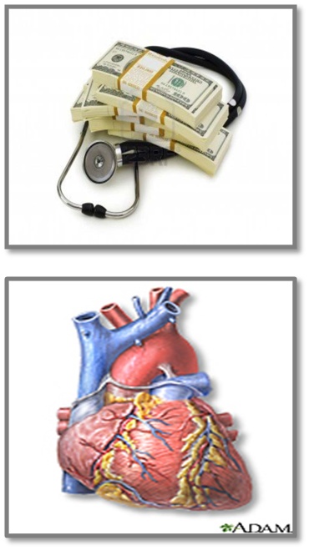
Despite Recent Advances in CVD Management –
Improvement in Risk Reduction is Needed
Cardiovascular disease (CVD) is the leading cause of death in U.S.
Despite guideline-driven health care, CVD still accounts for over 33% of all deaths in both men and women¹
50% of men & women who have a heart attack have a normal total LDL cholesterol³
Mozaffarian D, Benjamin EJ, Go AS, et al. Heart disease and stroke statistics – 2015 update: a report from the American Heart Association. Circulation. 2015;131(4)e29-e322.
Sachdeva A, Cannon CP, Deedwania PC, et al. Lipid levels in patients hospitalized with coronary artery disease: an analysis of 136,905 hospitalizations in Get With The Guidelines. Am Heart J. 2009;157:111-117.e2.
3. http://www.nlm.nih.gov/medlineplus/images/heart.jpg
Notes:
Speaker Notes
Key Point: Improvement in CVD Risk Reduction Is Needed Despite Advances
Cardiovascular disease (CVD) is the leading cause of death in the US, despite guideline - driven care.¹ In every year since 1900 except 1918, [Spanish Flu Epidemic),CVD accounted for more deaths than any other major cause of death in the U.S.
Despite the recent decline in CVD death rate, CVD still accounts for 33% of all deaths.² Currently, CVD claims more lives each year than cancer and chronic lower respiratory disease combined. On average, greater than 2150 Americans die of CVD each day, an average of 1 death every 40 seconds.
Total CVD healthcare costs in 2011 were $320.1 billion, by 2030 projected to be $918 billion.² CVD costs more than any other diagnostic group.
50% of people who’ve had a heart attack have normal cholesterol.³
Given this reality the routine lipid panel misses many individuals that are at risk for CVD
and yet the routine lipid panel remains the standard of care for CVD screening in the U.S.
References:
1.Mozaffarian D, Benjamin EJ, Go AS et al. Circulation. 2015;131:e129.
2.Mozaffarian D, Benjamin EJ, Go AS et al. Circulation. 2015;131:e4-5,e282.
3.Sachdeva et al. Am Heart J. 2009;157:111-117.e2
http://www.nlm.nih.gov/medlineplus/images/heart.jpg
Images are stock photo #5282591

Slide 9
What Actually Causes a ‘Heart Attack’?
CVD starts with Inflammation within the endothelium of the artery
Plaque is formed when LDL Cholesterol enters the inflamed area
Result: “Atherosclerosis” – an inflammatory disease of arteries
Notes:
Cardiologists have told my patients in past that plaque is normal as the age.
”Plaque is common, but it is NOT normal; it is a disease. Many believe that blockage of arterial blood flow plaque is the problem. It is if it’s in the anterior descending coronary artery and exceeds 70 to 80%. It becomes a plumbing problem. But fixing the plumbing problem does not alter one's risk of having a heart attack. The disease is a medical problem..

Slide 10
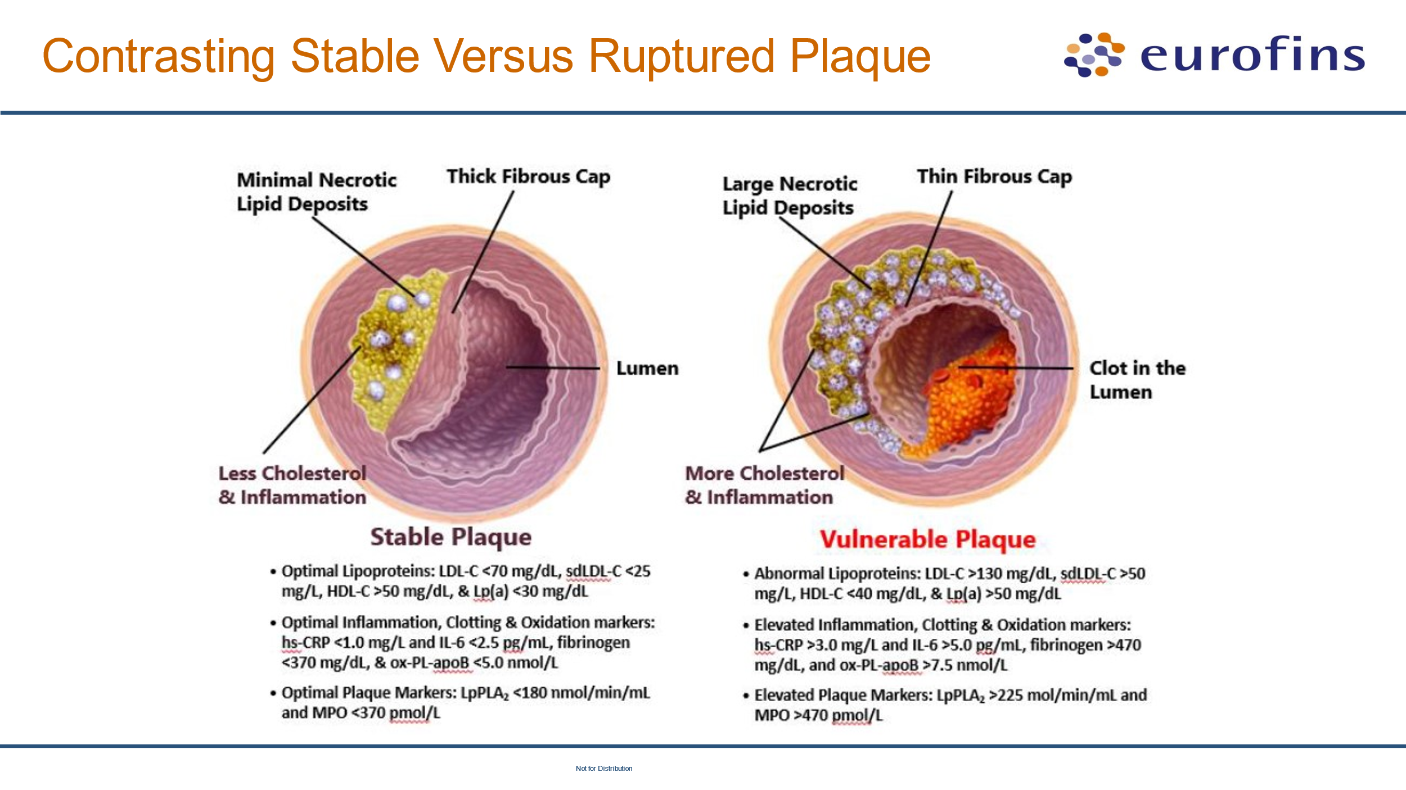
What Actually Causes a ‘Heart Attack’?
Notes:
Key: Type of plaque is critical - Stable or Unstable can be reflected in elevated plaque markers.
Plaque tends to be self-propagating

Slide 11
What Actually Causes a ‘Heart Attack’?
    Key Points
    Inflammation within intimal layer of arteries is the root cause of plaque
    Presence of ANY plaque = Vascular Disease = High Risk
    Most heart attacks occur with only MILD plaque (< 30%)
    Severe obstruction by plaque (> 80% stenosis) occurs within:
      Coronary arteries: causes angina (chest pain w/ exertion)
      Carotid arteries: causes NO symptoms
    Cardiovascular disease can be preventable & reversible !!!

Slide 12
What Actually Causes a ‘Heart Attack’?
High Risk Patient
Positive Personal Hx of having a CVD event
LDL-C >190 mg
Diabetes Mellitus aged 40-75 years old AND LDL-C of 70-189 mg
AHA Rx for High Risk: moderate or high-intensity statin therapy
Negative Personal Hx of CVD with Calculated 10-year Risk > 7.5%
Notes:
Identifying patients who are at HIGH RISK

Slide 13
How To Determine Your Risk of a Heart Attack or Stroke?
Atherosclerotic Cardiovascular Disease (ASCVD) Risk Calculator
Used in clinical settings to estimate a 10-year and lifetime risk for heart attack or stroke
among adults aged 20 and older who do not already have ‘known’ cardiovascular disease.
The ASCVD risk calculator uses 9 key factors to estimate risk:
Age
Diabetes status
Gender
Smoking status
Total cholesterol
HDL cholesterol (often referred to as "good" cholesterol)
Systolic blood pressure
Treatment for hypertension
Race
>7.5% - 20% = Intermediate Risk >20% = High Risk
Notes:
Gender: Female risk less than men until after menopause
Over two decades ago I stopped playing the percentage game for my patients. I began using carotid and peripheral artery duplex scans to diagnose disease.
A person either had disease and were therefore high risk, or they didn’t and were low risk at that time of their life. If they tested negative, then I repeated the test every two years.
Most of them subsequently developed disease in their arteries and generally they had not taken true ownership of their healthcare.

Slide 14
How To Determine Your Risk of a Heart Attack or Stroke?
  IF no known personal history of CVD disease, Imaging Studies may detect the presence of plaque for High-Risk DX
    CACS [CT scan of heart]: Detects Calcified plaque (Calcium Score)
    CIMT [carotid intimal media thickness] by ultrasound
    Carotid Artery Doppler U/S: Detects Calcified and Soft plaque
    CTA [computed tomographic coronary arteriography]: Suspected CAD

Slide 15
Significant Residual Risk for Cardiovascular Events Remains Despite LDL-C Lowering Therapy
0
100
[-20]
-38%
-25%
-25%
-27%
-31%
-38%
80
Reduction in Major
Coronary Events (%)
[-40]
60
[-60]
40
[-80]
62%
75%
75%
73%
69%
62%
20
Residual Major
Coronary Events (%)
[-100]
0
Trial
N
4S
4,444
LIPID
9,014
CARE
4,159
WOSCOPS
20,536
WOSCOPS
6,595
AFCAPS/TexCAPS
6,605
Secondary Prevention
High Risk
Primary Prevention
Adapted from Libby P. The forgotten majority: unfinished business in cardiovascular risk reduction. J Am Coll Cardiol. 2005;46(7):1225-1228.
Notes:
Speaker Notes
Key Point: Treatment for dyslipidemia aimed only at LDL-C lowering does not achieve optimal reductions in risk of CVD events.
This slide shows a number of clinical end point trials that used statins only to lower low-density lipoprotein cholesterol (LDL-C). Lowering of LDL-C resulted in a relative risk reduction in major coronary events between 25% to 38% with an average relative risk reduction of 30%.
The question remains, what are we doing to reduce the remaining 60-75% residual risk?
Key
4S- Scandinavian Simvastatin Survival trial
LIPID- The Long-Term Intervention with Pravastatin in Ischemic Disease study
CARE- Cholesterol and Recurrent Events trial
HPS- Heart Protection Study
WOSCOPS-The West of Scotland Coronary Prevention Study
AFCAPS/TexCAPS-Air Force/Texas Coronary Atherosclerosis Prevention studies
Reference
Adapted from Libby P. The forgotten majority: unfinished business in cardiovascular risk reduction. J Am Coll Cardiol. 2005;46(7):1225-1228.

Slide 16

Know Your Risk:
If you’re just measuring basic lipids:
Cholesterol, LDL, HDL, & Triglycerides,
You maybe believe
you are healthy and risk free from a heart attack or stroke
BUT: You will be missing the whole picture
and the RESIDUAL 65% of ‘at risk’ patients
Notes:
Speaker Notes
You may have had elevated cholesterol and placed on a statin medication for your LDL.
Key Point: Better diagnostic methods are needed to adequately identify all individuals at risk of CVD.
A key question for clinicians is how do we address the remaining 70% to 75% residual risk for CVD in a patient who is receiving a statin for dyslipidemia?
Clinical trials using tests not found on a routine lipid panel have identified multiple additional markers that identify CVD risk; and advanced CVD risk markers are needed to identify disorders that contribute to the remaining 70-75% residual risk.¹⁻³
The tests developed by Boston Heart can help to identify underlying factors that contribute significantly to increased risk of CVD.
References
Asztalos BF, Cupples LA, Demissie S, et al. High-density lipoprotein subpopulation profile and coronary heart disease prevalence in male participants of the Framingham Offspring Study. Arterioscler Thromb Vasc Biol. 2004;24(11):2181-2187.
Asztalos BF, Collins D, Cupples LA, et al. Value of high-density lipoprotein (HDL) subpopulations in predicting recurrent cardiovascular events in the Veterans Affairs HDL Intervention Trial. Arterioscler Thromb Vasc Biol. 2005;25(10):2185-2191.
Lamon-Fava S, Herrington DM, Reboussin DM, et al. Plasma levels of HDL subpopulations and remnant lipoproteins predict the extent of angiographically-defined coronary artery disease in postmenopausal women. Arterioscler Thromb Vasc Biol. 2008;28(3):575-579.
16

Slide 17
Key Point
If you only rely on:
      Symptoms
      Routine Physical Exam
      Routine Basic Lab Tests
      ECG
You won’t know your actual risks
You won‘t know your residual 65% risk

Slide 18
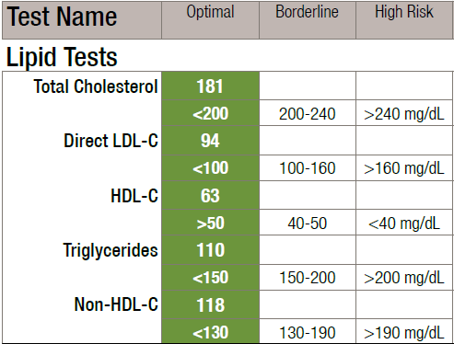
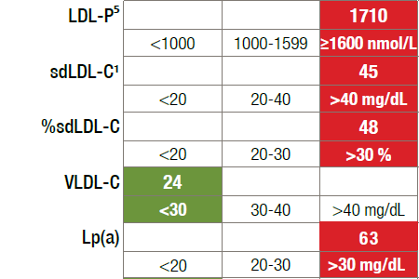
“Tip of the Iceberg”
What the Basic Lipid/ Cholesterol Panel Misses
Notes:
The "L" stands for "lipoproteins". Cholesterol is a fat and cannot be in the bloodstream by itself. So it attaches to a water soluble molecules called lipoproteins, which come in all size groups - LDL, HDL, VLDL, Triglycerides. They all carry cholesterol. All LDL-C is NOT atherogenic. Only the small and dense particles and Lp(a) are dangerous.

Slide 19
Why “Advanced” Lipid Tests are Useful
1. 50% of cases CHD is diagnosed at the time of SUDDEN Death.
2. Most patients with CHD do NOT have a classic lipid disorder or elevated LDL-C.
More people on a statin drug have a heart attack or stroke, than the number protected by a statin
Reminder: CHD is a Family Disease.
“Advanced” lab tests can identify a large portion of the patients at a future risk of a heart attack or stroke and provide a guide for treatment.
Sachdeva A, Cannon CP, Deedwania PC, et al. Lipid levels in patients hospitalized with coronary artery disease: an analysis of 136,905 hospitalizations in Get With The Guidelines. Am Heart J. 2009;157:111-117.e2.
Superko HR, King S 3rd. Lipid management to reduce cardiovascular risk: a new strategy is required. Circulation. 2008;117(4):560-568; discussion 568.
21
Notes:
I would now like to turn our focus to women. Let’s look at some sobering facts.

Slide 20
Cardio-Vascular Disease (CVD) in Women
The leading cause of death for women
Impacts >500,000 women each year in U.S.
Claims more female lives than all forms of cancer combined
For over 3 decades more women than men have died from CVD
64% of women who die suddenly of CVD had NO previous symptoms
Coronary Heart Disease (CHD) death rates in younger women (35-54 yrs.)
  Increasing for first time in 4 decades
  Why? Obesity, Diabetes, and Hypertension

Slide 21
Cardio-Vascular Disease (CVD) in Women
Symptoms of a Heart Disease Event Can Be Different
Women under the age of 55 are 7X more likely to be misdiagnosed than men with a heart attack, especially when they present without chest pain.
Atypical Symptoms Women May Present With :
Pain in the Arm or Shoulder
Indigestion or Nausea or Reflux Symptoms
Back Pain
Jaw Pain
Overwhelming Fatigue
Shortness of Breath

Slide 22
Cardio-Vascular Disease (CVD) in Women
Often a Different Disease than in Men
Women have less obstructive main coronary artery disease (CAD) due to atherosclerotic plaque
    Higher rates Micro-Vascular Disease (plaque) (MVD)
    Higher rates of plaque erosion & micro-embolization (clots)
  Women can be in heart failure & have normal ECHO cardiograms
  Women can be having a heart attack with no evidence of coronary artery blockage (normal arteriogram) AND be discharged home.
  Result: Missed diagnosis leads to higher death rates in women
Notes:
WISE Study

Slide 23
CVD in Women:
Role of Menopause & Estrogen Deficiency
Significant cardiovascular risk factor changes occur in women’s lipid (cholesterol) profile during her peri-menopausal years, especially in the year before & after cessation of menstruation:
  Increase: ApoB, LDL-C, sdLDL-C, VLDL-C, Total-C, & Lp(a)
  Decrease: HDL-C
  Changes are greater with Diabetes
Same changes occur in Premature Ovarian Failure (early menopause)
Notes:
We have known for a long time that women have a lower incidence of heart attacks than men BEFORE menopause, only to significantly increase after 5 yrs. post-menopause.
WHY?

Slide 24
CVD in Women:
Role of Menopause & Estrogen Deficiency
Increased risk of CVD effects in post-menopausal women is directly attributed to the Loss of estrogen’s beneficial on:
  Cholesterol levels
  Body fat - distribution from somatic to visceral (belly)
  Blood coagulation
  Insulin resistance/sensitivity
  Arterial elasticity/vasodilation
  Endothelial function (inner lining of wall of artery)
Notes:
So far, I haven’t discussed any symptoms that would indicate something might be wrong (except chest pain)

Slide 25
What is Menopause?
Menopause (Cessation of menstruation for > one year) - Aver. Age: 51 yrs.
Over 2 million women reach menopause each year
Impact of menopause wasn’t realized until the 2nd half of 20th Century during which time nearly ALL CVD research studies conducted were on men
Average Life Expectancy of women born in:
1920: 51 yrs.
1960: 74 yrs.
2023: 80.2 yrs. (Men: 74.8 yrs.)
Notes:
I would like to put this subject menopause into a little perspective.
Menopause is a phenomenon that that began LESS than 100 years ago.

Slide 26
History of Menopause & Estrogen
1686: Salem, Mass: 14 ‘witches’ are executed; 13 were of ‘menopausal’ age
1872: England: Menopausal women were classified as having ‘incurable dementia’
1942: FDA approval for Premarin use for estrogen replacement therapy
1975: NEJM reports possible link between estrogen and breast cancer
1977: Estrogen - possible link with endometrial (uterine) cancer
Notes:
Progesterone was not available in the early yrs of ERT. In fact, progestogen was introduced and became widespread in the mid 1970s two reduce the risk of endometrial, hyperplasia and cancer.

Slide 27
History of Menopause & Estrogen
  1990’s:
  Over 90% of women in their 50’s who had a hysterectomy used estrogen.
  Estrogen therapy was the ‘standard of care.’
  Premarin was the most frequently prescribed drug in U.S.
  Premarin sales in U.S. reached $1 billion annually

Slide 28
History of Menopause & Estrogen Controversy
“When It All Went Wrong”
1991: NIH launched the now famous Women’s Health Initiative (WHI Study)
      Multinational clinical trial designed to test the effect of postmenopausal hormone therapy, diet, calcium and Vit-D on the risk of:
        Heart Disease, Bone Fracture, Stroke, Breast and Colorectal Cancer.
      161,808 “healthy” postmenopausal women aged 50-79 years were enrolled
      Average Age: 63 yrs. 12 yrs AFTER average menopause onset!!
      Note: Only 10% of enrollees were between the age of 50-59
      Three Arms of the WHI Study:
        Estrogen Alone (Premarin) (E)
        Estrogen + Provera (medhydroxy-progesterone) (E+ P)
        Placebo
Notes:
It wasn’t until 1987 that the NIH established a policy first published in the NIH Guide for Grants and Contracts that women had to be included in clinical research studies
Principle authors were 3 epidemiologists, and one internist/obstetrician.
Study design was flawed from the beginning primarily due to the ages of the patient selection
Outcomes were based on self-administered mailed in questionnaires to 40 clinical centers

Slide 29
History of Menopause & Estrogen Controversy
“When It All Went Wrong”
2002: WHI Study was stopped prematurely, concluding that :
“Estrogen was associated with an INCREASED risk for Breast Cancer and Heart Attacks” and was initially reported in a world press release.
    (E + P) Arm: slight increased risk of heart disease, stroke, blood clots, and breast cancer.
    NOTE: Results did not meet statistical significance and were later found to be invalid. NO announcement to the women in the world press.
    (E alone) Arm: slight increased risk stroke and blood clots; no benefit on heart attacks and slight decreased risk of breast and colon cancer and osteoporosis but this was NOT released in the press release.
Remember: Average age of enrollees – 63 yrs.
Notes:
Outcomes were bases on self-administered questionnaires

Slide 30
History of Menopause & Estrogen Controversy
“When It All Went Wrong”
    Impact of Release of 2002 WHI Study:
      “Hot Flash Hell” felt around the world
      Fear caused women to stop taking their HRT
      Uncertainty caused physicians to stop prescribing hormones
      Result (in the U.S.):
      Rx’s decreased from 61 million in 2001 to 21 million in 2004
      40 million women had stopped their hormone therapy!!1

Slide 31
History of Menopause & Estrogen
Long Term Impact of the 2002 WHI Study Report
In addition to the 40 million women who went off their HRT, there is an additional generation of women (> 40 million) from 2002 to present who have purposely avoided or been denied hormone replacement therapy.
WHY? Since 2002 the medical teaching institutions, governmental health agencies and medical insurance companies have continued to follow the original WHI report that HRT may be harmful, causing breast cancer and heart disease and should only be used for severe menopausal symptoms and only for the shortest period of time.

Slide 32
What Do We Know in 2024?
North American Menopause Association (NAMS)
2017 NEW Position Statement:
“their prior 2012 Position Statement on HRT was NOT Valid”
"their prior concept of lowest dose HRT for the shortest period
of time was inadequate or even harmful for some women”
JoAnn Pinkerton, MD, Executive Director of NAMS and Professor of Obstetrics and Gynecology,
University of Virginia Health System in Charlottesville
July 2017 – Volume 24, Issue 7, p728-753

Slide 33
North American Menopause Society (NAMS)
2017 NEW Position Statement (cont.)
Original authors of the WHI Study published their 18-year follow-up results in
Journal of the American Medical Association (JAMA):
“Estrogen alone or Estrogen + Progesterone was NOT associated with any increase in all-cause mortality OR cause-specific mortality, including:
cardiovascular disease mortality,
cancer mortality (including breast cancer) and
other major causes of mortality after 18 years of follow-up!”
Manson JE, Aragaki AK, Rossouw JE, et al. Menopausal Hormone Therapy and Long-Term All-Cause and Cause-Specific Mortality
The Women’s Health Initiative Randomized Trials Mortality Risk. JAMA Sept. 12, 2017;318:927-938.

Slide 34
NAMS 2017 NEW Position Statement (cont.):
For Women over 60 years of age and Long-Term Use of HRT?
“When HRT is initiated in women who are 10 or more years AFTER their menopause, the benefit/risk ratio of HRT is less favorable than it is for younger women”.
“However, there is NO evidence to support routine discontinuation of HRT after the age of 65”.
AND “If women do discontinue HRT (as 40 million women did after 2002):
  “… there is a 50% chance that vasomotor symptoms will return, regardless of their age or how long they've been using it.”
  "With discontinuation of HRT, virtually all women will lose bone-mineral density, with an increased risk of bone fractures and excess mortality from hip fracture”.

Slide 35
What Do We Know in 2024?
NAMS 2022 Hormone Therapy Updated Position Statement
Key Points
HRT remains the most effective treatment for vasomotor symptoms (VMS) and genitourinary syndrome of menopause (GSM) AND to prevent bone loss and fracture
Benefits of HRT outweigh the risks for symptomatic women < 60 years and within 10 years of menopause onset
Paucity of trial data about the risks of HRT use in women older > 60-65 years
Select survivors of breast and endometrial cancer use of vaginal ERT greatly improves quality of life.
Breast cancer risk does NOT increase with use of estrogen-progestogen therapy AND may be DECREASED with estrogen alone.
HRT does NOT need to be routinely discontinued in women older than 60 or 65 years!

Slide 36
Why is Estrogen So Important to a Woman’s Health?
What has happened to the 80 million women not on Estrogen?
Estrogens directly influence the normal physiological functions in all mammals,
Estrogen (17β-estradiol) mediates its effects by binding to estrogen receptors (ERα & ERβ), which triggers distinct signaling pathways to regulate a broad range of estrogen responsive genes within each cell.
Estrogen receptors are found within the nuclei of most cells of the female body, including non-reproductive tissues:
  Cardiovascular
  Skeletal
  Central Nervous and Cognition
  Fat Metabolism
  Immune System
  Liver, Skin, Kidneys, Erythropoetic and Spleen
Notes:
NOT just about “hot flashes & night sweats”

Slide 37
Why is Estrogen So Important to a Woman’s Health?
What has happened to the 80 million women not on Estrogen?
Estrogens are also implicated in numerous diseases, most of which occur as a result of the absence of estrogen (higher risk) and shown to be beneficial with HRT:
Various Types of Cancer
    Breast
    Ovarian
    Colorectal
    Endometrial
    Osteoporosis

Slide 38
Why is Estrogen So Important to a Woman’s Health?
What has happened to the 80 million women not on Estrogen?
    Neuro-Degenerative Diseases:
      Stroke
      Parkinson’s Disease
      Alzheimer Disease
      Multiple Sclerosis
    Insulin Resistance / Type 2 Diabetes
    Auto-Immune Disease (Lupus Erythematosus)
    Central Obesity
    Endometriosis (estrogen dependent)

Slide 39
Common Symptoms of Menopause
Vasomotor
Physical
Cerebral

Slide 40
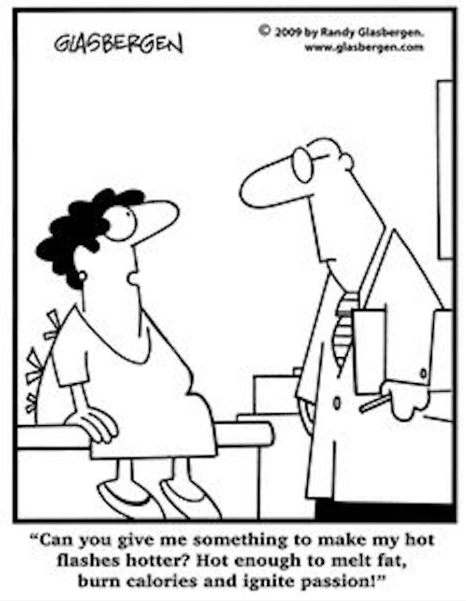
What About Symptoms of Menopause?

Slide 41
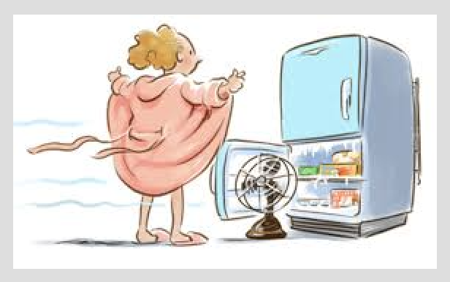

Slide 42
Common Symptoms of Menopause
Vasomotor (Controlled by the brain)
        Hot flashes
        Perspiration and night sweats
        Role of Blood Brain Barrier
    Physical
      Palpitations of the heart
      Vaginal dryness and irritation / dyspareunia
      Bladder symptoms & frequent infections
      Skin changes
      Joint pain (arthralgia)
      Muscle pain (myalgia)
      Dry eyes

Slide 43
Common Symptoms of Menopause
Cerebral (brain)
  Irritability
  Lethargy – Mental & Physical Fatigue
  Anxiety
  Mood Swings
  Tension & Irritability
  Difficulty Concentrating / Lack of Focus
  Brain Fog
  Short-Term Memory Loss
  Insomnia / Lack of Sleep
  Depression
  Decreased Libido (sex drive)

Slide 44
What are the Short-Term Benefits of HRT in Women?
“RELIEF” from Symptoms
Vasomotor (Hot Flashes & Night Sweats): ⬇⬇ Dose related / Blood-Brain Barrier
Sleep Disturbance - ⬇ – REM sleep improved
Anxiety/Depressive Symptoms – ⬇
Cognition & Short-Term Memory Loss - ⬇ (“Windex to My World” = Mental Clarity)
Atrophic Genital Changes – ⬇
Lower Urinary Tract – Urinary tract infection, Urinary incontinence, OAB - ⬇

Slide 45
What are the Long-Term BENEFITS of HRT in Women?
What “Evidence-Based” Research Reveals:
CVD: Heart Attack - ⬇ 50%; Stroke – Neutral to ⬇
Type II Diabetes - ⬇
Breast Cancer – WHI: Neutral to ⬇ & (21- 40% in multiple studies
Colorectal Cancer – WHI: slightly ⬇
Endometrial Cancer – ⬇ (Preventable w/ progesterone or bazedoxifene-DuaVee)
Ovarian Cancer – WHI: Neutral to slight ⬇
Osteoporosis (Bone Loss & Fracture) - ⬇
Blood Clots (VT/PE) – 2X ⬆ with oral estrogen ONLY (Role of Factor V & VII mutation)
Dementia & Alzheimer’s - ⬇ 30-50%
All Cause Mortality - ⬇ 30-60%
References: www.gordongunnmd.com > Menopause and Estrogen 2019

Slide 46
Overall Conclusions Regarding Benefits of HRT
Short Term Benefits:
Menopausal hormone therapy (ET/EPT) is the only 100% effective treatment for vasomotor and atrophic symptoms due to estrogen deficiency during the post-menopausal phase of life. Symptoms frequently recur when ET/EPT is stopped at any age.
Long Term (>20 Years Use) Benefits:
Benefits exceed any alleged risks; especially, when initiated within 10 years of menopause – “The 10-Year Window” theory.
  The absence of ovarian function and the resulting loss of circulating estrogen can cause significant reversible and irreversible physical changes and increase the risks of many quality of life conditions AND life-threatening diseases.
  Estrogen has been shown to be safe and protective after 20 yrs.+ of use.

Slide 47
My Recommendations for Women and HRT
  Educate your female patients as to the benefits of HRT
  Clarify the myths surrounding the use of menopausal HRT
  Remember who is the decision maker – The Patient
  Screen for CVD and cancer risks (breast and uterine) before initiating HRT
  Personalize HRT based on clinical factors, symptom control & patient preferences
  How long should women use hormone therapy?
    Their Lifetime

Slide 48
My Recommendations for Primary Prevention of CVD
  Diagnose & Monitor CVD: Carotid Artery Vascular Doppler Ultrasound
  Boston Heart Diagnostics Testing - Evaluation of residual 65% risk. (missed by the basic lipid panel):
    Enables targeted treatment management
    Matching appropriate therapy to specific abnormalities
    Provides accurate, actionable, practical information to improve patient outcomes
  Key Life-Style Behaviors:
  Nutrition [Boston Heart Personalized Nutritional Life Plan]
  Exercise
  Stress Management & Meditation
  Sleep
Women: Start HRT with onset of menopause

Slide 49
Primary Prevention of Heart Disease & Stroke
“What I Tell My Patients”
Goal: Live Well for their Lifetime
Heart attacks, strokes & diabetes are preventable!!!
  Be pro-active & take ownership of their health; Choose wisely
  Age-appropriate CVD, metabolic, genetic and cancer screening testing
  Embrace the Four Cornerstone Life-Style behaviors
  Use appropriate risk lowering medications & nutraceutical supplements
  Every choice made, every action taken, every day - has consequences
  It is never too late to re-invent yourself and acquire new habits
  Their health IS the best investment to achieve a life of Living Well

Slide 50
Six “C’s” for Achieving a Life of Living Well and Living Long
  Care for yourself – if you do not, no one else will; except maybe at your end of life
  Change - Be open and welcome the option of transformation. Review your trade-offs. What compromises are you are willing and not willing to make for a healthy life?
  Commitment - engage in healthy behaviors that will enhance your quality of life
  Connectedness to others – social connections play a key role in longevity
  Consistency in your actions = perseverance = sustainability.
  Newly learned behaviors require practice, practice, and more practice to create and instill in your brain new neurogenic pathways (neurogenesis). These pathways become the new normal in spontaneous behavior patterns
  Control - learn to be rooted and centered in your daily life through mindful meditation. Consider learning the practice of Tai Chi
  Gordon C. Gunn, M.D.

Slide 51
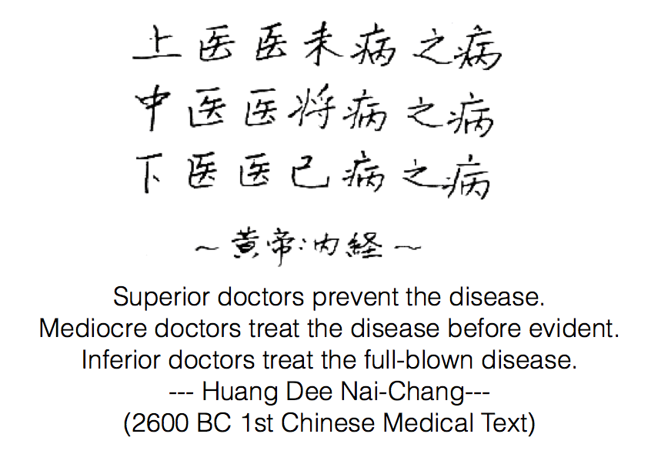
Follow the Path of Primary Prevention

Slide 52
Thank you
For further information visit:
www.gordongunnmd.com
Review:
“Longevity Program”
“Life-Style Articles”
“Health Articles”

